Slide 1

Financial Times Advanced Analytics
Amy Symes-Thompson, Connor Byrne, Michal Chadzynski

Slide 2

Introduction
Agenda
Data engineering – Our ingestion journey
Analysis – Net-zero investment
Q&A

Slide 3


Who are we? What is Financial Times data?
Advanced Analytics are a team of data scientists within DESNZ working on several cross-cutting projects.
Financial Times is a broadsheet publication focusing on global business and economic current affairs.
We have access to articles from 2005 to present day
We download articles on a daily basis via an API -> real time indicator of news/trends.
API is accessed via Python package requests.
Data is downloaded, stored and managed via Amazon Web Services (AWS).

Slide 4

Our FT ingestion journey

Slide 5
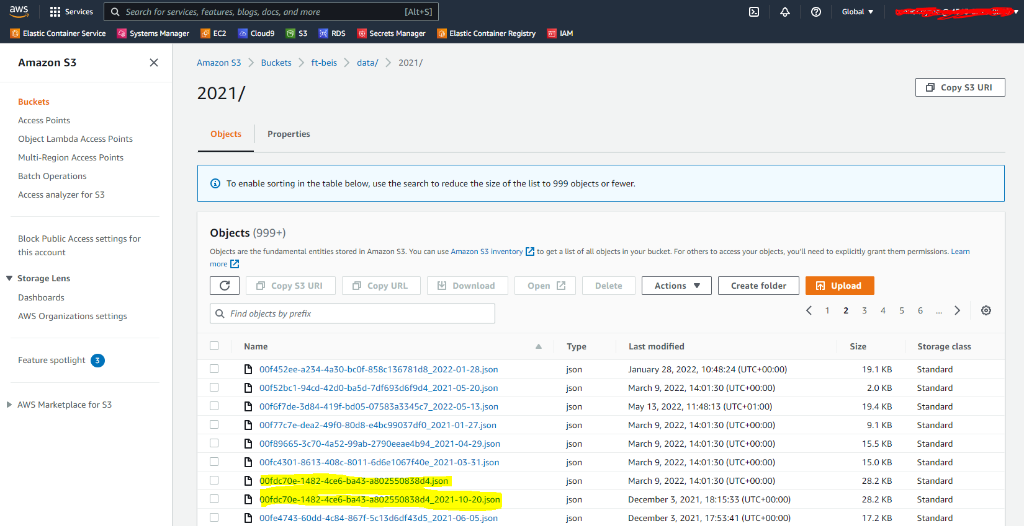
How was the data previously ingested?
Code stored on a GitLab repo
Calls an API, every 6 hours
Stores each article as a json file in s3 bucket
Could be improved:
Data is stored but not cleaned; should do this as part of the ingestion
Slow to pull in individual json files to collate into a data frame
Process has allowed duplicates to creep in (highlighted articles)
Notes:
- We started this project with some code stored on a GitLab repository
- The code helped build a Batch job on AWS that calls the FT API every 6 hours and downloads the necessary data
- Each FT article is stored as a json file with AWS’ s3 bucket service, a glimpse of which you can see on the right hand side
- However, early on in the project we could see that this was not an optimal data process
- Firstly, the data was stored in a messy format containing Unicode and html tags so it meant that you would always need to clean the data when using it

Slide 6

What were the starting aims for the FT data ingestion project?
Data should be stored on a database
Data should be normalised
Data should be accessible via an IDE for easier viewing
Text data should be cleaned as part of the ingestion process
Data interaction should be easier to use
A log of data ingested should be created and maintained
Incorporate tests within code
Better management and documentation within GitLab repo
Ingestion process should be easy to update and track updates

Slide 7
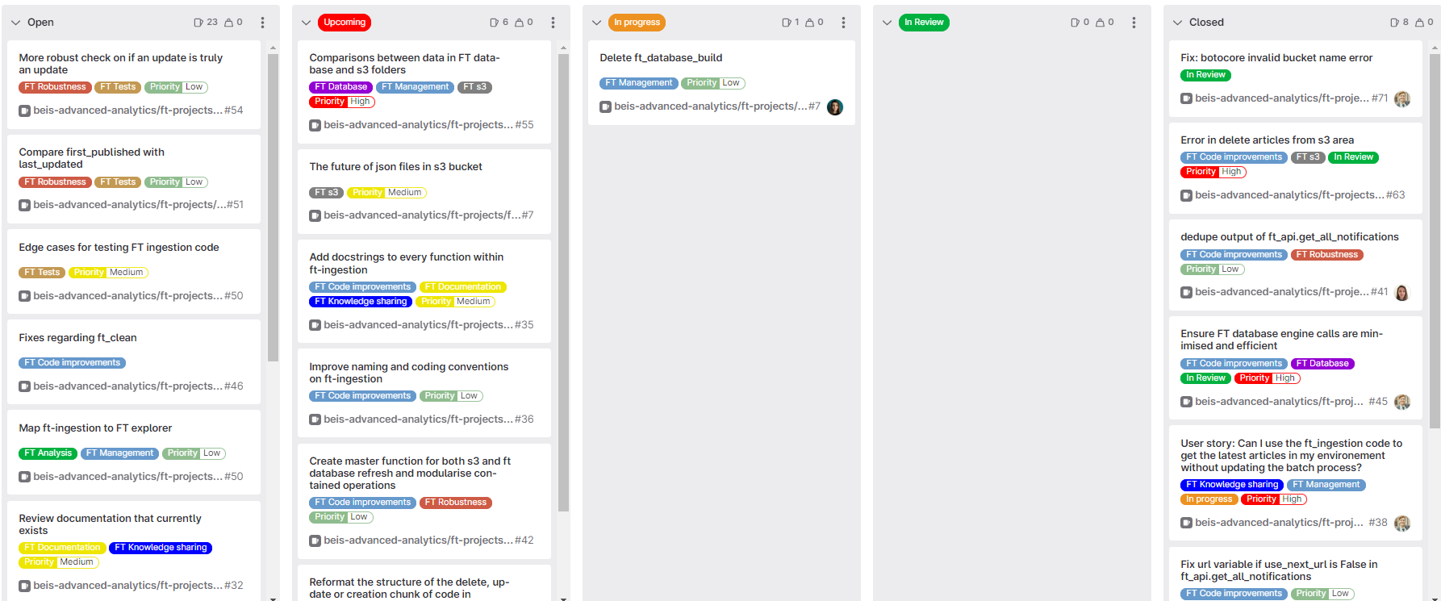
How did we plan to carry out these ingestion improvements?
Agile WoW
2 week sprints to work through GitLab tickets (issues)
Milestones and ticket boards

Slide 8



1. Data should be stored on a database
This was going to help us store and import data more efficiently, and later be able to view data in an easier way
Within AWS, we can create them via the Relational Database Service (RDS). This is a web service that provides capacity for a relational database to be stored on AWS’ web cloud.
It is password protected and we’ve created bespoke functions to allow users to access the data smoothly
ft-database
ft-database-secret
ft_db.py
import psycopg2
import sqlalchemy
_get_ft_secret
Get the credentials for ft-database-secret
_get_ft_engine
Use credentials to connect with database
_pandas_query
Use connection to import data

Slide 9
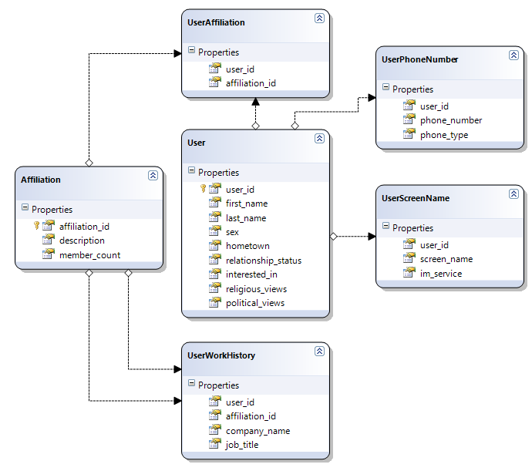
Data normalisation
Database normalisation is the process of structuring a relational database in accordance with a series of so-called normal forms in order to reduce data redundancy and improve data integrity (Wikipedia).
Some benefits of data normalisation are:
Faster, precise calls to import data
Optimal data management (reduced database size and costs)
Prevents duplicate data, potentially resulting in inconsistency or corruption

Slide 10
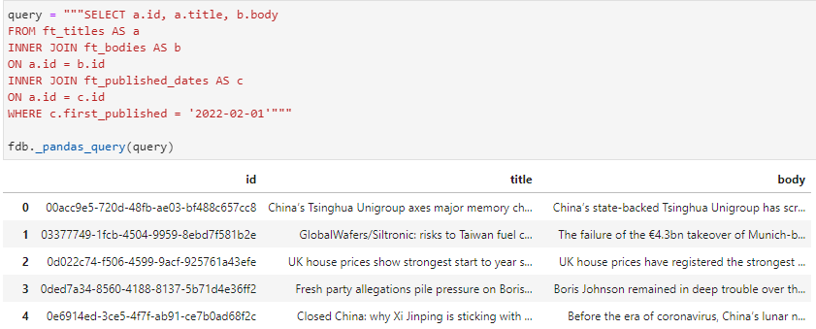
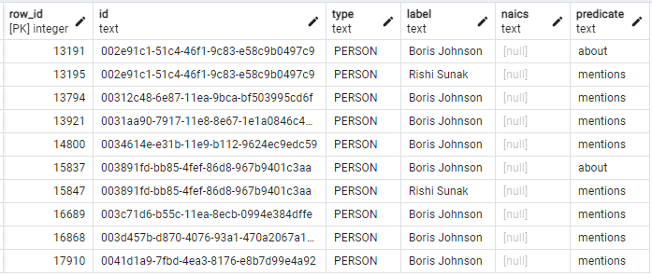


2. Data should be normalised
Within the ingestion code, we added a stage in which each element of the main dataset was split into individual tables along with the common variable id
For each table, id was used as a primary key: it needed to be a unique variable and an error was result if the same id was imported into a data table more than once.
This resulted in faster calls and more precise data calls from the user
Still room for improvement in reducing data redundancy for annotations
Three tables combined to make one

Slide 11
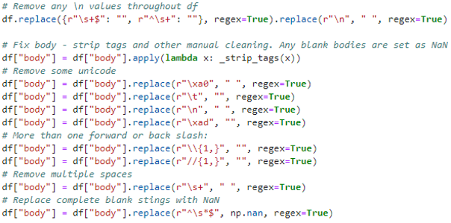
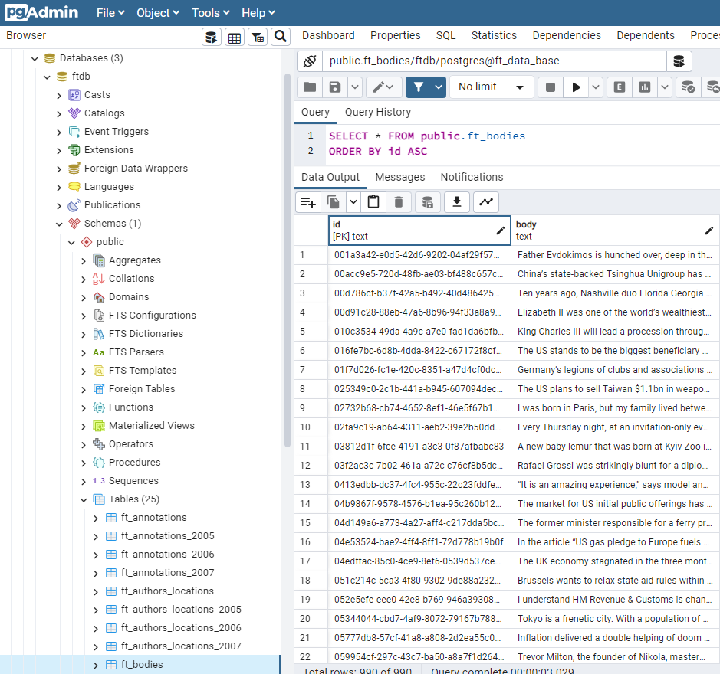
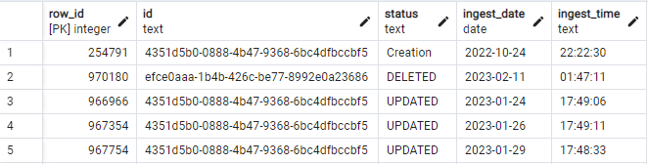
Other aims included an IDE, text cleaning and a log
…we cleaned text data as part of the ingestion (part of this is below)…
We used pgAdmin (PostgreSQL) for an IDE…
…and a log table is updated whenever an ingestion takes place.

Slide 12


A quick note on the FT ingestion batch job
A rough guide on how a batch job works in AWS:
AWS Batch setup
Job definition
Clone into Cloud9 to test
Build and run a docker image based on the code
Push to AWS’ ECR
Job queue
Develop code in Git repo
Latest docker image for job
Compute environment
No direct link between image and the code used to build it
Job runs!
Notes:
How a batch job works in AWS:
- All our code is written in Python and stored in a Git repository via GitLab
- Once we are ready to update a batch job process, we will clone that repo in a Cloud9 environment. Cloud9 is cloud-based IDE to develop and debug code. In this context, we use it as the environment is similar to that of which the batch job will operate in, so we have a greater sense that there will be no unexpected surprises in store regarding installing packages or other things.
- Within Cloud9, we build and run a docker image using our code. Within going into docker in too much detail, docker is an open platform that you can manage infrastructure with. In this instance, we are building an image (also known as a container image) which contains everything needed to run an application - all dependencies, configurations, scripts, binaries, etc. The image also contains other configuration for the container, such as environment variables, a default command to run, and other metadata. In our case, it enables us to set everything up to run the batch job, in other words: call the API, download and clean our data before storing it.
- After we build and run the image and are happy with it, we store that image in AWS’ Elastic Container Registry which is essentially a repository for images and provides some version control to these images.
- This results in our latest docker image for the batch job being ready, and with some additional setup on AWS Batch jobs, our job should run successfully.
- The point we are trying to get across is that there is no direct link between the image and the code used to build it, so we had to think about a way in which to track updates

Slide 13
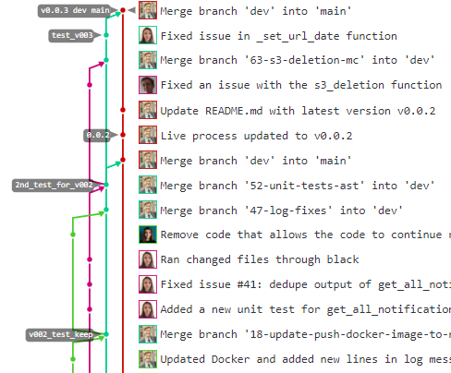
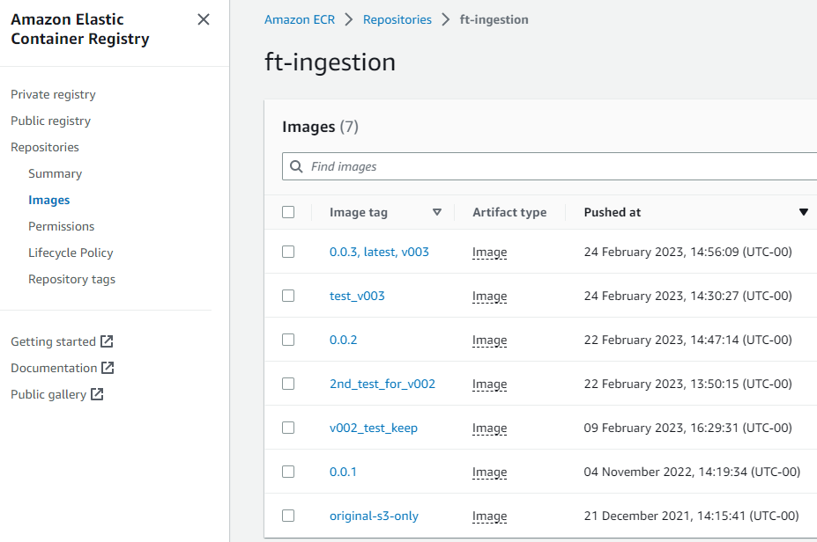
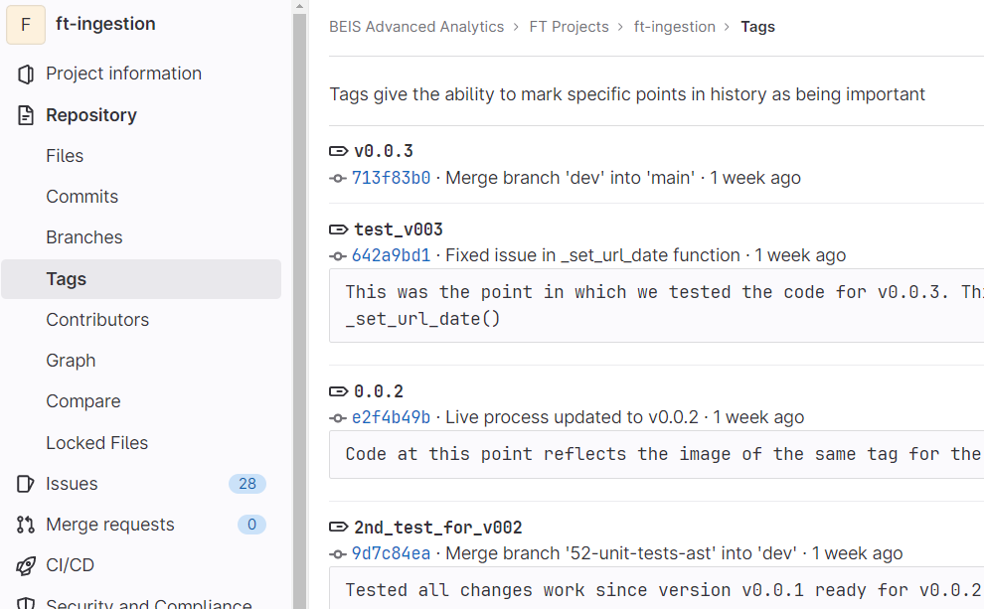
9. Ingestion process should be easy to update and track updates
Using GitLab tags, we can mark points in our code history that reflect different stages in its development
In parallel, we can tag docker images with matching references
Notes:
- That is where tagging came into play. Tags in GitLab are useful marks you can add to your code history
- Alongside this, you can tag docker images within the ECR.
- This allows us to see what version of the code was used to create images

Slide 14




Ingestion successes
Easier access to data
Faster process
Debugging smoother
Tests add robustness

Slide 15

Net-zero investment

Slide 16
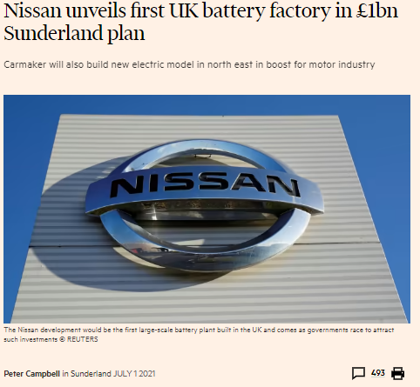
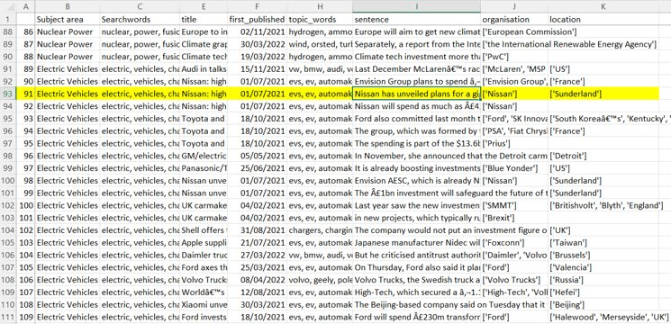
Introduction
NZ colleagues using Bloomberg to find examples of net zero investment.
Can we use a topic model to identify net zero related articles?
Could we use FT to quickly identify examples of investment in these articles?
What context could it provide: who and where?
“Nissan has unveiled plans for a gigafactory battery plant as part of a £1bn investment in its Sunderland plant.”

Slide 17

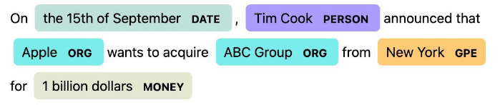
Mapping tools: 1) Extracting locations with SpaCy
Extracting locations as text strings: Named-entity recognition (NER) from SpaCy package
We extracted everything that was labelled 'GPE' (Geo-political entity) from our article bodies
The GPE label is used for countries, cities, states etc.
Locations don't have a sense of scale associated with them...

Slide 18

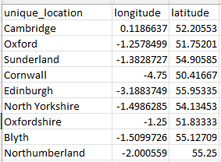

Mapping tools: 2) Geocoding with GeoPy
2) Geocoding: obtaining coordinates from text string locations
Nominatim
Nominatim: open-source geocoder. Free, but low request limits.
Needed to use a function called RateLimiter to add a time delay between requests.

Slide 19


Mapping tools: 3) Mapping with Folium
3) Creating maps: folium package
Folium is based on the Leaflet JavaScript library
Start with basic map tiles and iteratively add map elements such as points, hover boxes, clusters, legends...
By default, creates a map in a separate HTML file

Slide 20
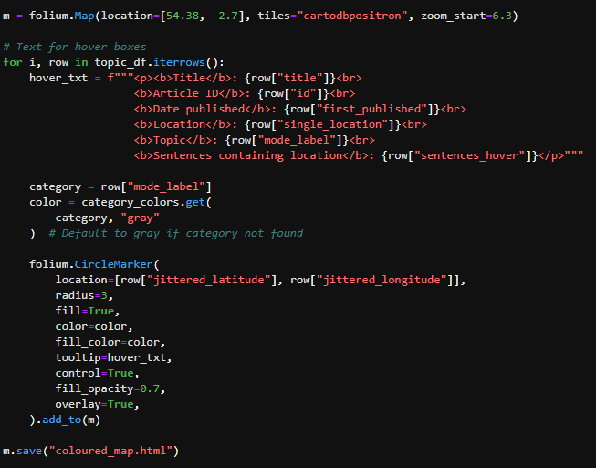
Example code for circles map
Create basic map
Create html text for hover boxes
Add circle markers

Slide 21
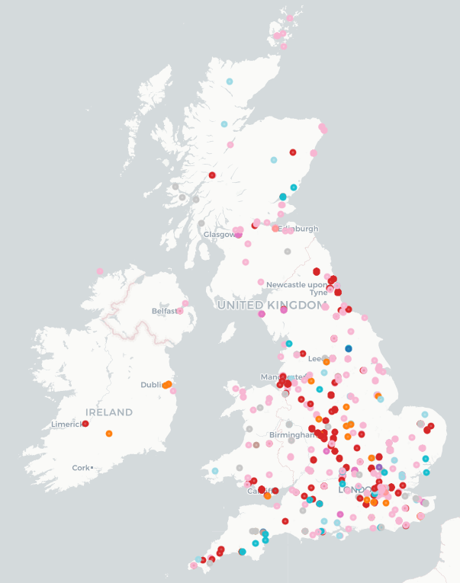
Visualisations – 1
We’ve also coloured points based on the most dominated topic. This gives a greater sense of what areas of net zero are being linked to certain locations.
Battery
Renewables
Sustainability governance
Plastic
Drought
Wildlife
“Britishvolt, founded in 2019, has been promised £100mn in funding from the UK government but must begin construction on the site in Blythe, Northumberland to unlock the money..”
“Ford said last year it would spend £150mn to transform its components plant at Halewood on Merseyside to make parts for electric vehicles.”
“In the search for technologies, Brazil’s Aerotec Fund invested £3.7m in Abingdon-based Oxis Energy in February.”
OFFICIAL SENSITIVE - ANALYSIS UNDER ACTIVE DEVELOPMENT - INDICATIVE OUTPUTS WHICH ARE SUBJECT TO CHANGE

Slide 22


Making a choropleth in folium
Working with
spatial data:
Need two essential pieces of data for a choropleth:
Geographic polygon data -UK county polygons from ONS Open Geography Portal
2) Numeric count data per polygon - article counts per county. needed to create

Slide 23
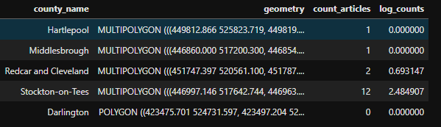
Making a choropleth in folium
To get numeric counts: align coordinate reference systems (CRS), then use spatial join (sjoin) method of geopandas to join points to polygons:
Then aggregate data to get article count per county. Final data for choropleth looks like :

Slide 24
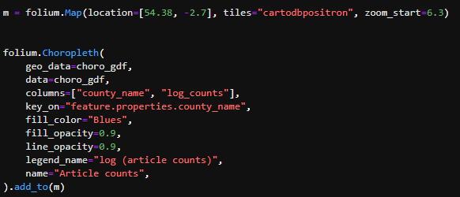
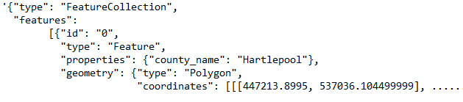
Choropleth tricky part – 'key_on' parameter
Unique key column, need to inspect original geojson file to find...

Slide 25
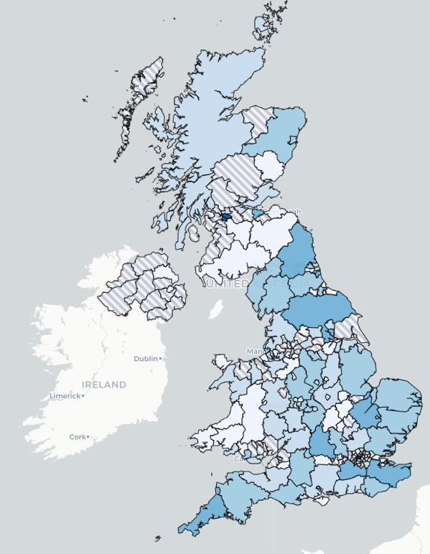
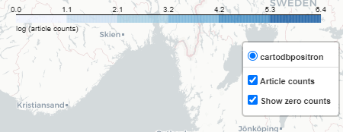
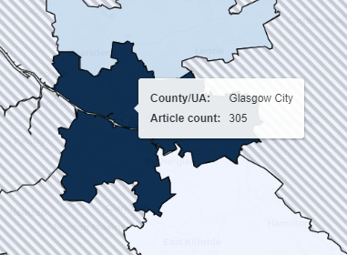
Visualisations – 2
Choropleth showing NZI article counts per UK county and Scottish UA
Log scale for shading
Diagonal grey lines for areas with no articles
Hover boxes:
Hotspots in London and Glasgow (COP)
OFFICIAL SENSITIVE - ANALYSIS UNDER ACTIVE DEVELOPMENT - INDICATIVE OUTPUTS WHICH ARE SUBJECT TO CHANGE

Slide 26
Where next?
Looking at NZI in the EU as well as the UK.
Distinguishing failed investment or planned investment from actual investment that has taken place.
Understanding how investment has changed over time.
Cross-checking with other news outlets or information sources.

